Slide 1



Walmart Stock Analysis
Group 11 presents an in-depth analysis of Walmart's stock performance, led by Parth Tripathi, Ruturaj Solanki, Chris Chhotai, Isha Dhaduk, and Manushree Venkatesh.
by Group 11

Slide 2

Walmart Stock Analysis
This presentation will provide a comprehensive analysis of Walmart's stock performance, financial metrics, and market position. We will delve into the company's history, growth strategies, and key factors influencing its stock price. Our goal is to equip you with a detailed understanding of Walmart's financial health and future prospects as an investment opportunity.

Slide 3

Agenda
Introduction - The introduction will provide an overview of the presentation, outlining the key topics that will be covered. This will set the stage for the audience and help them understand the scope and objectives of the analysis.
Company Valuation - The company valuation section will delve into an in-depth analysis of Walmart's financial performance and market position. This will include an examination of the company's assets, liabilities, revenue, and profitability, as well as a comparison to key competitors and industry benchmarks.
Business Model - The business model section will explore Walmart's unique approach to retailing, including its Omni-channel strategy, use of technology, and focus on low prices and wide product selection. This will provide insights into the company's competitive advantages and long-term sustainability.
Competitors - The competitors section will analyze Walmart's main rivals in the retail industry, such as Costco, Target, and Amazon. This will include an assessment of their market share, financial performance, and strategies, allowing for a comparative analysis of Walmart's position in the competitive landscape.

Slide 4

About Company
Walmart is an American multinational retail corporation that operates a vast network of discount department stores, grocery stores, and hypermarkets across the globe. Founded in 1962 by the visionary entrepreneur Sam Walton in Bentonville, Arkansas, Walmart has grown to become one of the largest and most influential retailers in the world, with over 11,000 stores spread across 27 countries. The company's success is largely attributed to its unwavering commitment to providing customers with a wide range of high-quality products at incredibly low prices, making it a go-to destination for cost-conscious consumers.
At the heart of Walmart's business model is a relentless focus on innovation and technological advancement. The company has been at the forefront of implementing cutting-edge inventory management systems, automated warehouses, and digital solutions that enhance the overall customer experience. From the seamless integration of online and in-store shopping to the introduction of groundbreaking services like Walmart+, the company has consistently demonstrated its ability to adapt to the ever-changing retail landscape and remain a dominant force in the industry.
Beyond its impressive operational capabilities, Walmart has also established itself as a socially responsible corporate citizen, with a strong emphasis on sustainability, community engagement, and ethical business practices. The company's commitment to reducing its environmental footprint, supporting local communities, and promoting diversity and inclusion has solidified its reputation as an iconic brand that has fundamentally transformed the face of retailing around the world.

Slide 5

Business Model
Walmart is a global retail giant, generating over $555 billion in net sales in 2021. The company operates a differentiated Omni business model with three primary units: Walmart U.S., Walmart International, and Sam's Club. Sam's Club, a membership-only warehouse club, accounts for approximately 12% of Walmart's net sales.
In addition to its brick-and-mortar stores, Walmart has also launched Walmart+, a subscription service that provides customers with unlimited free shipping, unlimited delivery from stores, and various discounts. By leveraging its scale, logistics network, and technological innovations, Walmart has established itself as a dominant player in the retail industry, offering customers a seamless and convenient shopping experience across multiple channels.
Walmart's business model emphasizes operational efficiency, cost leadership, and customer-centricity. The company's strong brand, extensive reach, and diversified revenue streams provide a solid foundation for future growth. However, Walmart faces intense competition in the retail industry from both traditional players and emerging disruptors. To maintain its market position and capitalize on growth opportunities, Walmart must continue to innovate and adapt to evolving customer preferences and market trends.

Slide 6
Top industrial competitors
Costco
Metro
Costco is a membership-only warehouse club that operates over 800 warehouses worldwide. With an estimated market share of around 9%, Costco is known for its low prices, wide selection of merchandise, and high-quality private label brands. Costco's focus on delivering exceptional value and customer experience has made it a formidable competitor to Walmart.
Metro is a leading grocery and pharmacy retailer in Quebec and Ontario, with an estimated 11% market share. As a publicly traded company, Metro has been focusing on expanding its footprint, improving operational efficiency, and leveraging its private label and digital initiatives to offer a more compelling value proposition to customers and compete with Walmart's low-price strategy.
Sobeys
Loblaws
Sobeys is the second-largest grocery retailer in Canada, with an estimated market share of around 20%. Owned by Empire Company Limited, Sobeys operates a network of grocery stores, pharmacies, and fuel stations across the country. Sobeys has been continuously investing in its digital capabilities, supply chain, and store renovations to enhance the customer experience and better compete with Walmart and other major players.
Loblaws is the largest grocery retailer in Canada, with an estimated 28% share of the Canadian grocery retail industry. As a subsidiary of George Weston Limited, Loblaws operates a diverse portfolio of grocery and specialty retail banners, including Loblaws, Zehrs, and Real Canadian Superstore. Loblaws' strong regional presence and focus on fresh food, private labels, and health-conscious offerings have made it a significant competitor to Walmart in the Canadian market.

Slide 7
Market Share
48%
16.62%
Individual Shareholders
Institutional Investors
16.17%
—
Mutual Fund Holders
Shareholder Breakdown
Walmart's market share is primarily held by individual shareholders (48%), followed by institutional investors (16.62%) and mutual fund holders (16.17%). This diverse shareholder base reflects Walmart's appeal to both retail and professional investors, contributing to its liquidity and stability. The breakdown of shareholders indicates a balanced mix of short-term and long-term investors.
These market share figures demonstrate Walmart's position as a mature, well-established company with a diverse and loyal shareholder base. This shareholder composition can be a key factor in the stock's stability and performance, as it suggests a balanced mix of short-term and long-term investors with varying investment horizons and risk profiles.

Slide 8
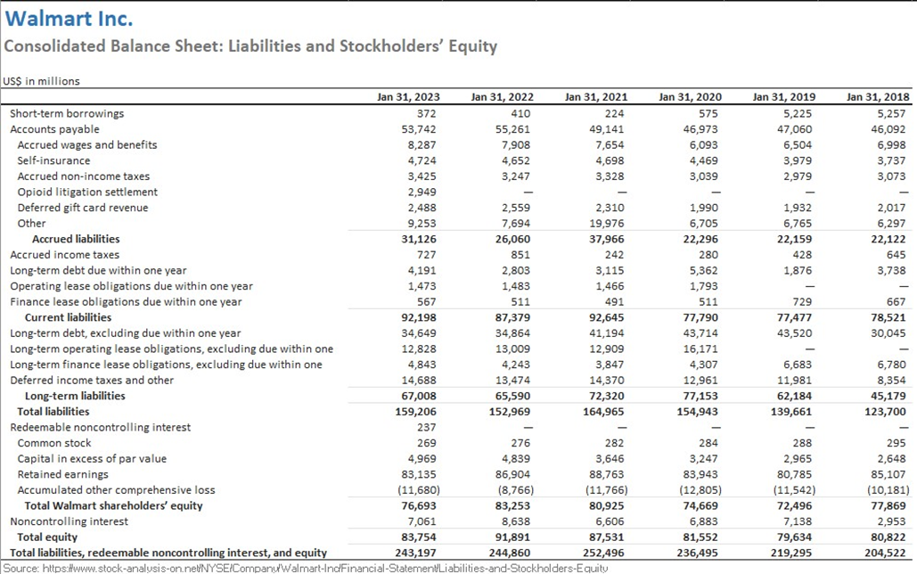
Balance Sheet
Walmart's balance sheet provides a comprehensive snapshot of the company's financial position, highlighting its assets, liabilities, and shareholders' equity. As a leading global retailer, Walmart's balance sheet reflects its extensive operations, robust asset base, and prudent financial management. The analysis of Walmart's balance sheet offers valuable insights into the company's financial strength, liquidity, and overall financial health, which are crucial factors for investors and analysts to consider when evaluating the company's performance and future prospects.

Slide 9
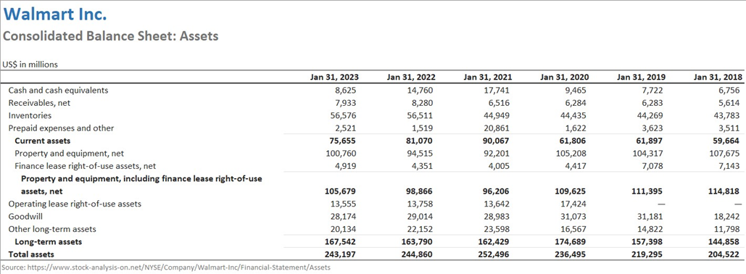
Ratio and Valuation Analysis using Ratio Analysis
To gain a comprehensive understanding of Walmart's financial performance and position, we will conduct a detailed ratio analysis. This analysis will involve evaluating a diverse set of financial ratios, including liquidity, profitability, efficiency, and leverage ratios. By examining these key metrics, we can assess Walmart's operational efficiency, solvency, and overall financial health. The insights gained from this ratio analysis will complement the balance sheet review and provide a more holistic assessment of the company's standing.

Slide 10
Liquidity Ratios Analysis
Current Ratio: 0.83
Quick Ratio: 0.24
This ratio indicates that Walmart's current assets are insufficient to cover its current liabilities, as evidenced by a current ratio of 0.83.
Moreover, the quick ratio of 0.24 implies that Walmart may face difficulty in meeting its short-term obligations with its most liquid assets.
Cash Ratio: 0.11
Limited Ability to Convert Assets to Cash
Additionally, the cash ratio of 0.11 suggests that Walmart has a relatively low level of cash reserves compared to its current liabilities, which may pose liquidity challenges in the short term.
This might be an indication of Walmart's limited ability to quickly convert assets into cash to meet immediate liabilities.

Slide 11
Profitability Ratios
Gross Profit Margin (GPM): Indicates that 24.38% of revenue is retained as gross profit after deducting the cost of goods sold.
Operating Profit Margin (OPM): Shows that 4.17% of revenue remains as operating profit after deducting operating expenses.
Return on Assets (ROA): Reflects that 6.15% of the company's total assets generate net income.
Return on Equity (ROE): Indicates that 11.28% of shareholder equity generates net income.
Return on Sales (ROS): Suggests a negative return of -16.04% on total sales, indicating a loss incurred.
Return on Investment (ROI): Shows that the company generates a return of 3.16% on its investments.
Price-to-Earnings Ratio (P/E Ratio): Indicates that investors are willing to pay $31.32 for each dollar of earnings per share.
Dividend Payout Ratio: Shows that 39% of earnings are distributed to shareholders as dividends.
Debt-to-Equity Ratio: Indicates a ratio of 0.61, implying that the company has a moderate level of debt relative to its equity.
Sustainable Growth Rate: Indicates that the company can grow its sales at a rate of 6.8808% while maintaining its current financial policies and ratios.

Slide 12

Ratio and Valuation Analysis using CAPM
We will use the Capital Asset Pricing Model (CAPM) to analyze Walmart's financial performance and stock valuation. CAPM helps determine the expected return on an asset based on its risk level. By applying CAPM, we can gain insights into Walmart's risk profile and potential returns for investors.
The CAPM formula calculates the expected return of an asset using the risk-free rate, market risk premium, and beta. Walmart's beta, which measures stock price sensitivity, will be a crucial input. A beta greater than 1 indicates higher volatility, while a beta less than 1 suggests lower volatility. Using Walmart's beta and other market data, we can determine the company's expected rate of return and assess stock valuation.
This analysis provides insights into Walmart's risk-reward profile and informs investment decisions. By understanding Walmart's CAPM-based valuation, investors can make informed choices based on their risk tolerance and return expectations.

Slide 13
Beta and CAPM Analysis
0.4582
—
Beta (β)
Stock Volatility
0.0168
—
Risk-Free Rate (rf)
Government Bond Yield
4.7666
—
Cost of Equity (CAPM)
Expected Return
Beta (β) measures the sensitivity of a stock's returns to changes in the market returns. A beta of less than 1 indicates that the stock is less volatile than the market. In this case, the beta value is 0.4582.
The risk-free rate (rf) represents the return on an investment with zero risk, often approximated by the yield of a government bond. In this case, the Canada Long Term Real Return Bonds Rate of 0.0168 is used.
The Cost of Equity (CAPM) calculated as 4.7666 suggests that investors would expect a return of approximately 4.7666% above the risk-free rate to compensate for the risk associated with investing in the stock, given its beta and the market risk premium.

Slide 14
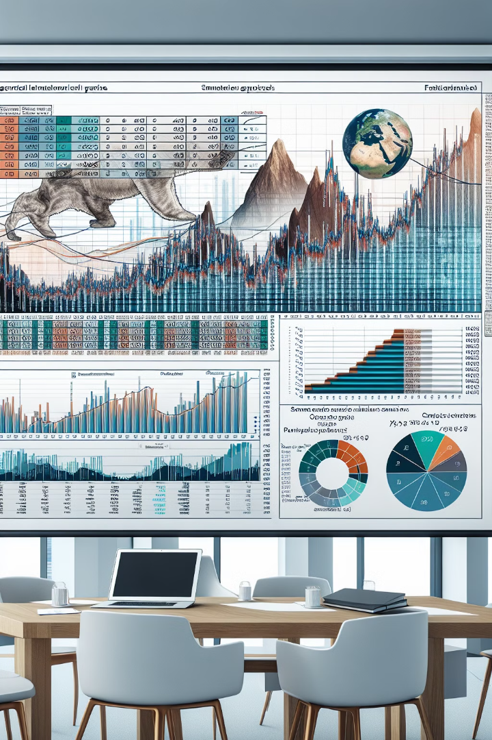
Monte Carlo Simulation
To further analyze Walmart's stock performance and potential future price movement, we conducted a Monte Carlo simulation. This advanced statistical technique involves generating multiple random price paths based on historical data, allowing us to model the uncertainty and volatility inherent in the stock market.
The simulation generated 10,000 potential price trajectories for Walmart's stock over the next 30 days. By analyzing the distribution of these simulated prices, we were able to calculate the expected average stock price and the probability of the price falling within certain ranges. This provides valuable insights into the potential upside and downside risks associated with investing in Walmart's shares.
The results of the Monte Carlo simulation suggest that the expected average stock price for Walmart over the next 30 days is higher than the current market price. This implies that there is a possibility of a rise in the stock price in the short term. However, it's important to note that this simulation does not guarantee future stock price movements, and further research and analysis should be conducted before making any investment decisions.

Slide 15
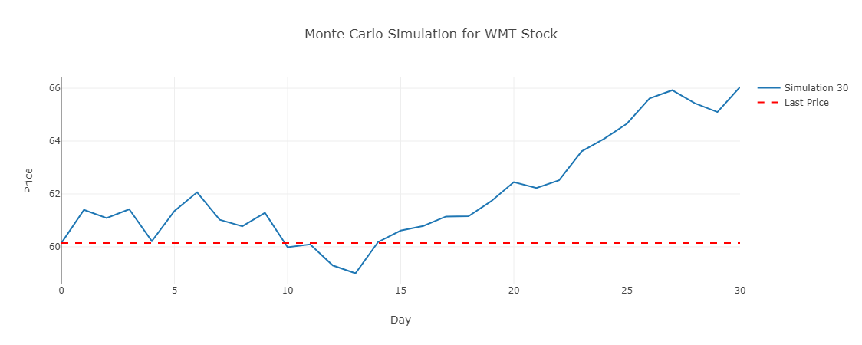
Monte Carlo Simulation

Slide 16
Monte Carlo Simulation
After running a Monte Carlo simulation of Walmart's adjusted closing price for the past two years, it was found that the expected average stock price for the next 30 days is higher than the current market price. This suggests that there is a possibility of a rise in the stock price in the short term. However, investors must exercise caution as this simulation does not guarantee future stock price movements. Further research and analysis should be conducted before making any investment decisions, as stock investment inherently involves risks, and past performance may not accurately predict future results.
The Monte Carlo simulation is a powerful tool that can provide valuable insights into the potential future performance of a stock. By running thousands of simulations based on historical data, the model can generate a range of possible outcomes and their respective probabilities. In the case of Walmart, the simulation indicates that the stock price may trend upwards in the near term, but investors should not solely rely on this projection. Other factors, such as macroeconomic conditions, industry trends, and the company's fundamental performance, should also be carefully considered before making an investment decision.

Slide 17

Simple Moving Average
In our analysis of Walmart's stock, we have plotted the company's closing price along with its 50-day and 100-day simple moving averages (SMA). The SMA is a widely used technical analysis tool that calculates the average price of a stock over a specific time period, smoothing out the daily fluctuations to provide a clearer trend line.

Slide 18
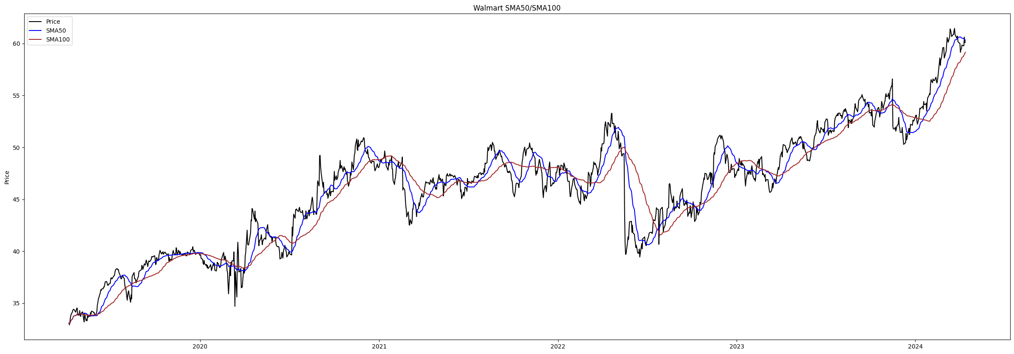
Simple Moving Average
In our analysis of Walmart's stock, we have plotted the company's closing price along with its 50-day and 100-day simple moving averages (SMA). The SMA is a widely used technical analysis tool that calculates the average price of a stock over a specific time period, smoothing out the daily fluctuations to provide a clearer trend line.
The 50-day SMA reflects the average of the last 50 trading days, while the 100-day SMA looks at the past 100 trading days. These two moving averages can provide valuable insights into the stock's momentum and potential support or resistance levels. When the stock price is above both the 50-day and 100-day SMAs, it may indicate a bullish trend, while a price below these moving averages could signal a bearish sentiment.

Slide 19
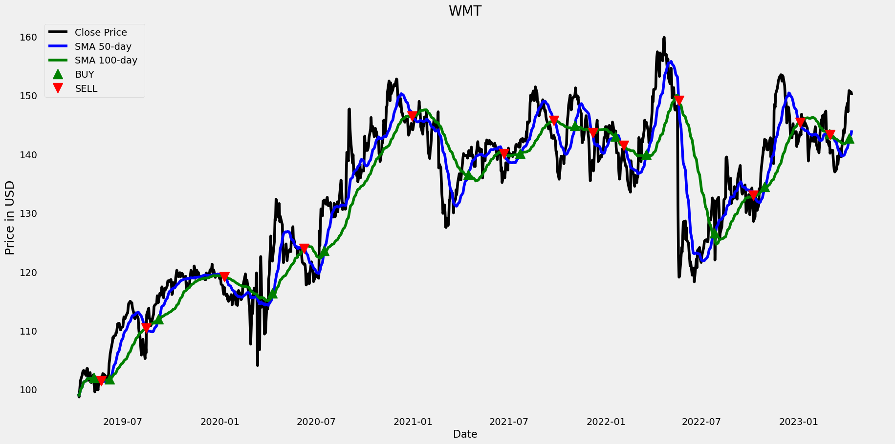
Exponential Moving Average
The exponential moving average (EMA) is a type of moving average that places a greater weight on the most recent data points. Unlike the simple moving average (SMA), which gives equal weight to all observations within the time period, the EMA assigns exponentially decreasing weights as the data gets older.
In the provided plot, we can see the 50-day and 100-day EMAs of Walmart's stock closing prices. The EMA is more responsive to recent price changes compared to the SMA, making it a popular tool for identifying short-term trends and potential buy/sell signals. The buy and sell indicators shown on the plot suggest when the stock's price has crossed above or below the EMA, potentially signaling a bullish or bearish trend.
By analyzing the relationship between the stock price, the 50-day EMA, and the 100-day EMA, investors can gain insights into the stock's momentum and make more informed trading decisions. The divergence or convergence of these lines can indicate the strength and direction of the trend, helping investors determine the optimal entry and exit points.

Slide 20
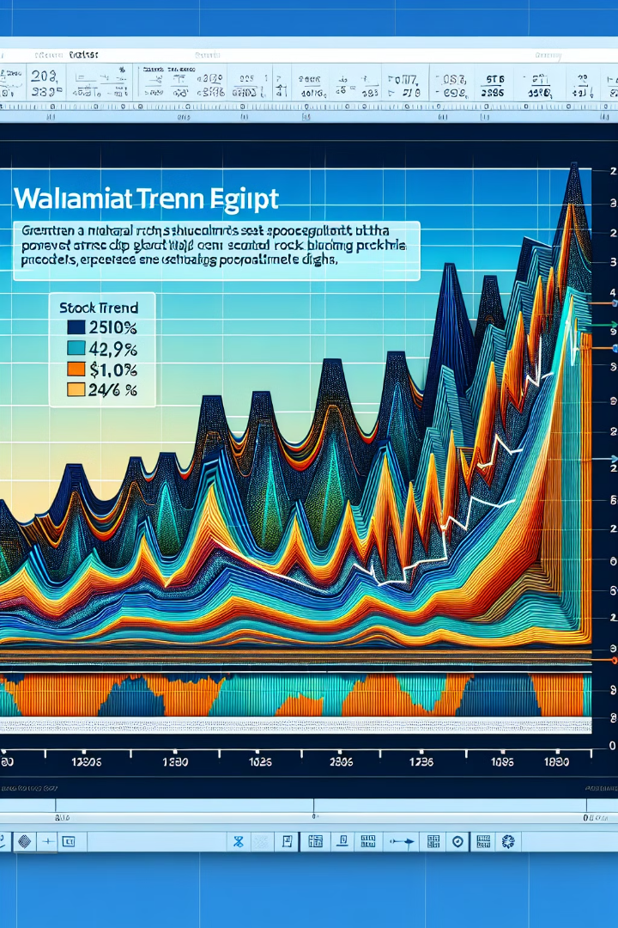
Facebook Prophet Analysis
This analysis utilizes the Facebook Prophet forecasting model to predict Walmart's stock price trajectory until 2024. The Prophet model is a time-series forecasting tool that can handle complex patterns in data, including seasonality, trends, and holidays. By feeding Walmart's historical stock data into the Prophet algorithm, we can generate a detailed forecast of the company's future stock price movements.
The Prophet analysis shows a generally upward trend in Walmart's stock price over the next few years, with some short-term fluctuations. The model predicts the stock will continue its steady climb, reaching new all-time highs by 2024 as the company maintains its position as a dominant force in the retail industry. This forecast reflects Walmart's strong fundamentals, efficient operations, and ability to adapt to changing consumer preferences and market conditions.
While the Prophet analysis provides a data-driven outlook, investors should still consider other factors, such as macroeconomic trends, competitive landscape, and company-specific news, when making investment decisions. The forecast serves as a valuable tool to inform decision-making, but should be used in conjunction with comprehensive research and analysis.

Slide 21

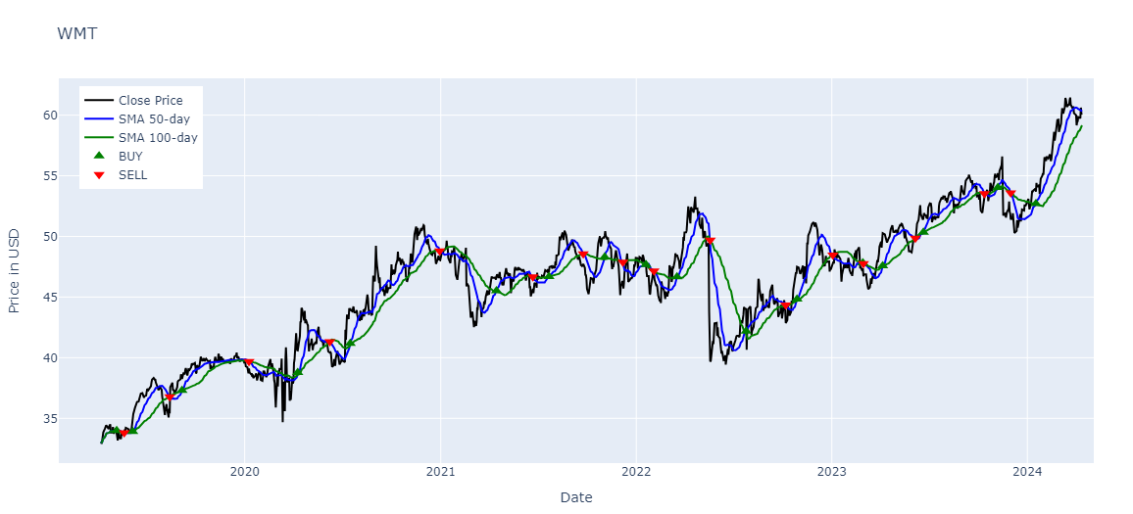
Walmart Stock Analysis
This presentation will provide a comprehensive analysis of Walmart's stock performance, financial metrics, and market position. We will delve into the company's history, growth strategies, and key factors influencing its stock price. Our goal is to equip you with a detailed understanding of Walmart's financial health and future prospects as an investment opportunity.

Slide 22

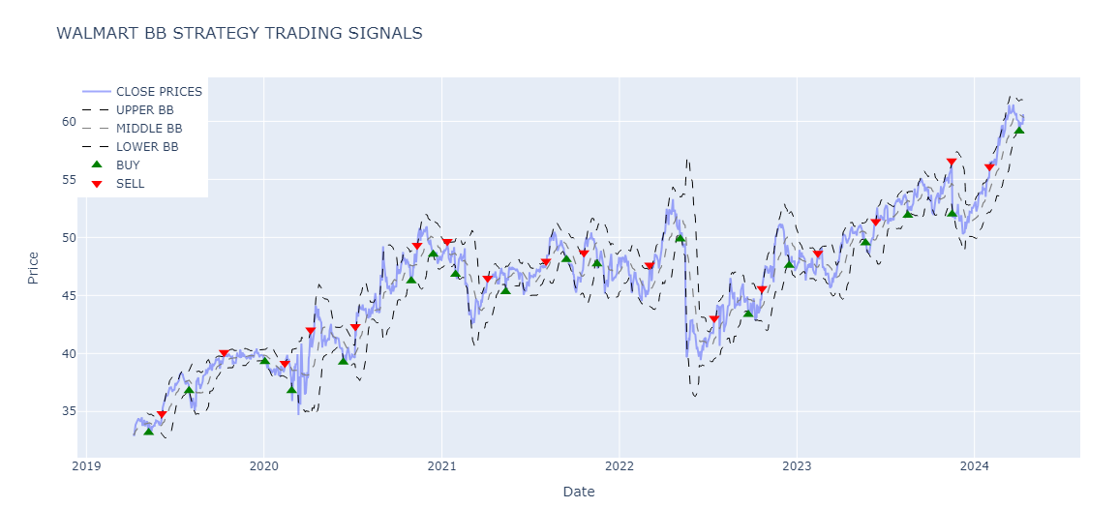
Walmart Stock Analysis
This presentation will provide a comprehensive analysis of Walmart's stock performance, financial metrics, and market position. We will delve into the company's history, growth strategies, and key factors influencing its stock price. Our goal is to equip you with a detailed understanding of Walmart's financial health and future prospects as an investment opportunity.

Slide 23

Recommendation
Walmart is a major global retailer and a blue chip investment. However, its fundamentals are shifting from a traditional value investment. While Walmart's financial performance remains impressive, it falls short in key metrics like return on equity, debt-to-equity ratio, and current ratio. Investors should closely examine Walmart's long-term prospects before making investment decisions.

Slide 24
References
To conduct a comprehensive analysis of Walmart's financial performance and competitive position, we have consulted a variety of authoritative sources:
PESTLE Analysis - The PESTLE analysis from PestleAnalysis.com provides valuable insights into the external factors shaping Walmart's business environment, including political, economic, social, technological, legal, and environmental considerations.
Business Model - The article from FourWeekMBA delves into the details of Walmart's differentiated omnichannel business model, comprising its Walmart U.S., Walmart International, and Sam's Club divisions, as well as the newly launched Walmart+ subscription service.
Competitor Analysis - The competitor analysis from BusinessChronicler examines Walmart's key rivals, such as Costco, Loblaws, Sobeys, Metro, and Target, providing crucial market share data and insights into the competitive landscape.
Financial Data - The stock data and financial ratios from CSIMarket.com offer a comprehensive view of Walmart's financial performance and valuation metrics compared to its industry peers, enabling a thorough assessment of the company's competitive positioning.
These sources have provided a robust foundation for our in-depth analysis of Walmart's business, financial performance, and competitive landscape. By leveraging this comprehensive data and research, we are able to deliver a well-informed and insightful assessment of the company's current state and future prospects.

Slide 25

Thank You
Thank you for the opportunity to present our comprehensive analysis of Walmart's financial performance and market position. Throughout this presentation, we aimed to provide you with a thorough understanding of the company's operations, competitive landscape, and future prospects.
Your trust and collaboration have been instrumental in the success of this project. We appreciate the insights and guidance you have provided, which helped us deliver a tailored analysis that addresses your specific needs.
We hope that the insights and recommendations we have shared will prove valuable in your decision-making process. We are available to address any additional questions or concerns you may have and look forward to working with you again in the future.

Slide 26
Conclusion
In conclusion, our comprehensive analysis of Walmart's financial performance and competitive position has provided valuable insights into the company's strengths, challenges, and future prospects. While Walmart remains a dominant player in the retail industry, our findings suggest that investors should closely examine the company's long-term fundamentals before making investment decisions.

